Slide 1

Basic setup and first program

Slide 2
Basic configuration
Throughout this course we will use Eclipse IDE
Eclipse version should be Enterprise Edition (JEE)
We will need to add Spring Framework and Maven to the Eclipse
Maven should be already included in newer Eclipse versions

Slide 3
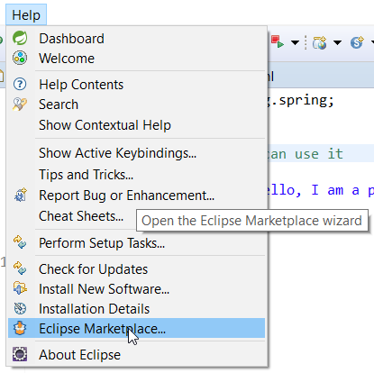
Basic configuration
Easiest way to install additional libraries is through Eclipse Marketplace

Slide 4
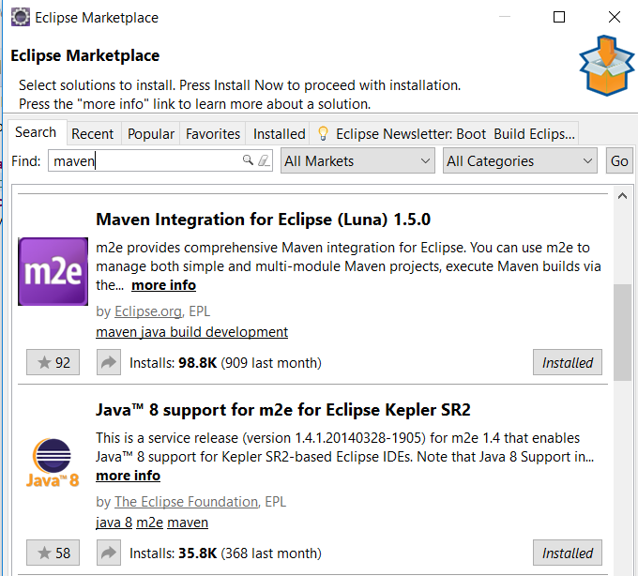
Basic configuration
Maven Integration

Slide 5
Basic configuration
Maven is a tool that can now be used for building and managing any Java-based project.
Maven attempts to deal with:
  Making the build process easy
  Providing a uniform build system
  Providing quality project information
  Providing guidelines for best practices development
  Allowing transparent migration to new features

Slide 6
Basic configuration
Maven allows a project to build using its project object model (POM) and a set of plugins that are shared by all projects using Maven, providing a uniform build system.
Maven provides plenty of useful project information that is in part taken from your POM and in part generated from your project’s sources. For example, Maven can provide:
  Change log document created directly from source control
  Cross referenced sources
  Mailing lists
  Dependency list
  Unit test reports including coverage

Slide 7
Basic configuration
Maven aims to gather current principles for best practices development, and make it easy to guide a project in that direction.
For example, specification, execution, and reporting of unit tests are part of the normal build cycle using Maven. Current unit testing best practices were used as guidelines:
  Keeping your test source code in a separate, but parallel source tree
  Using test case naming conventions to locate and execute tests
  Have test cases setup their environment and don’t rely on customizing the build for test preparation.

Slide 8
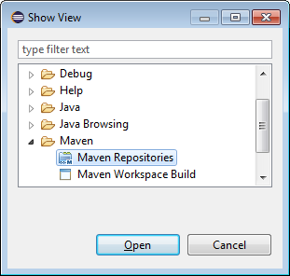
Basic configuration
After adding Maven Integration, or if it was already included in Eclipse, it is usually needed to rebuild indexes for the first time
On the top menu bar, open Window -> Show View -> Other
In the Show View window, open Maven -> Maven Repositories

Slide 9
Basic configuration
In the window that appears, right-click on Global Repositories and select Go Into
Right-click on "central (http://repo.maven.apache.org/maven2)" and select "Rebuild Index"
  Note that it will take a while to complete the download
Once indexing is complete, Right-click on the project -> Maven -> Add Dependency and start typing the name of the project you want to import (such as "hibernate").
  The search results will auto-fill in the "Search Results" box below.

Slide 10
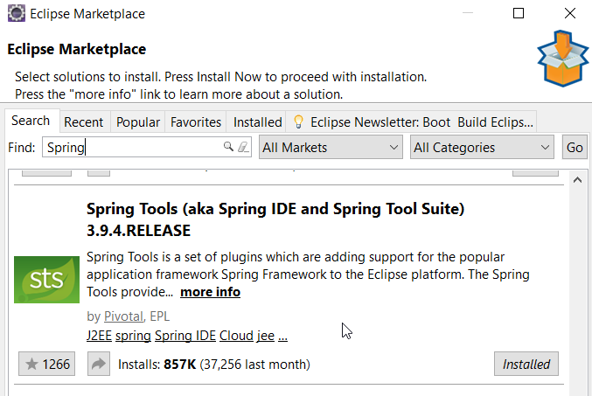
Basic configuration
Spring also needs to be added to Eclipse

Slide 11
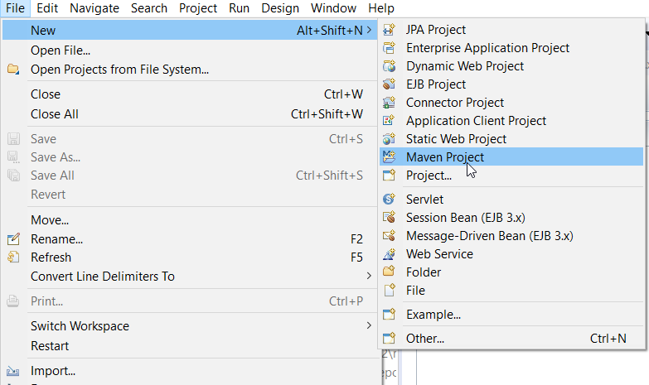
First project
How to create first Spring project using Maven?

Slide 12
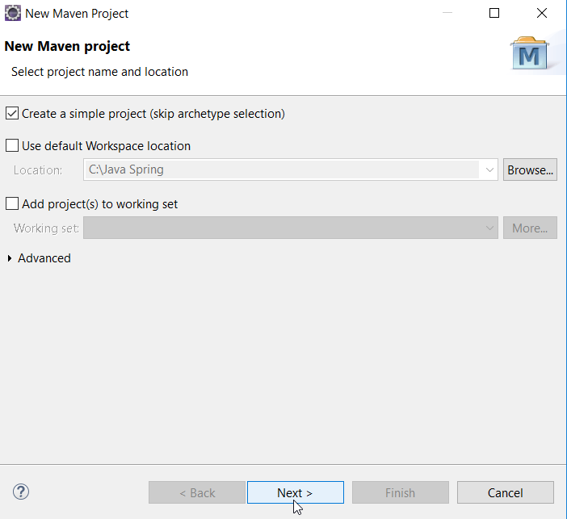
First project

Slide 13
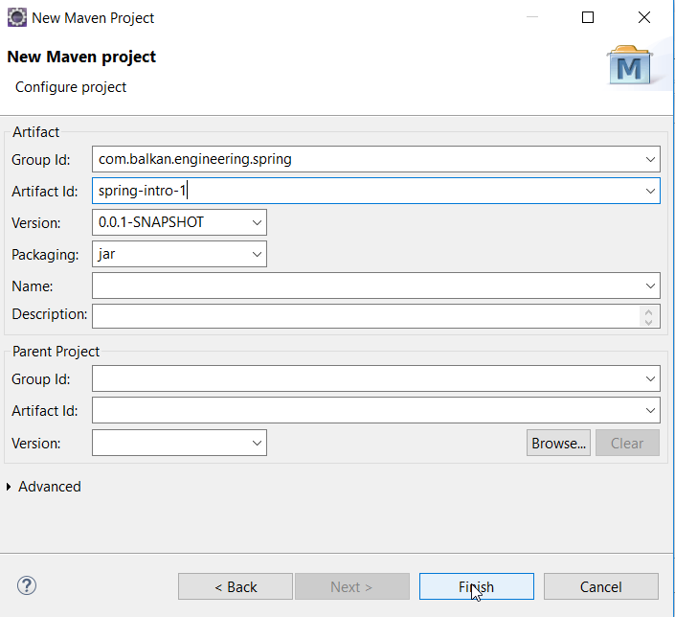
First project
Group Id – package name
Artifact Id – program name

Slide 14
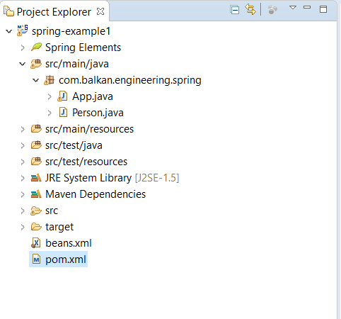
First project
Maven project setup

Slide 15
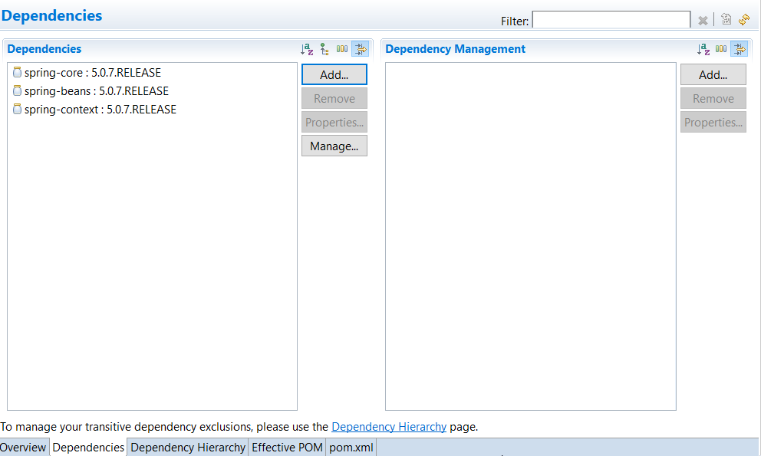
First project
Add dependencies

Slide 16
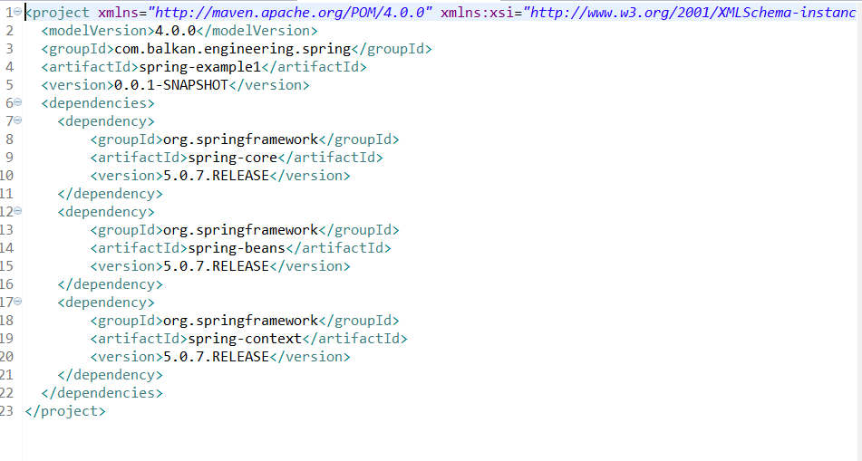
First project
POM looks like this:

Slide 17
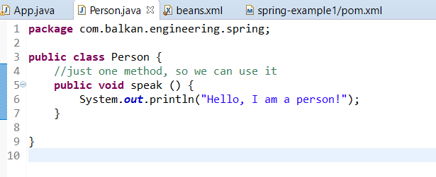
First project
Create simple Person.java class

Slide 18
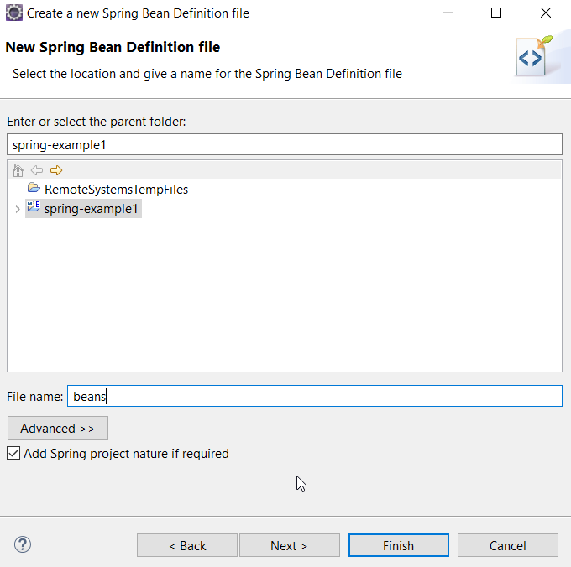
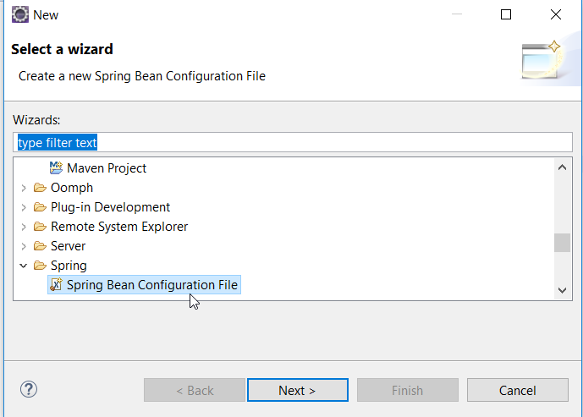
First project
Add beans.xml file

Slide 19
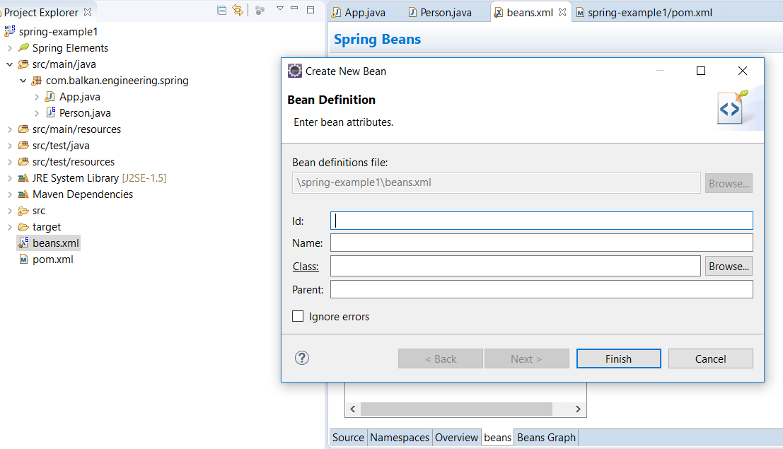
First project
Open beans.xml, select beans and add new bean for Person class

Slide 20
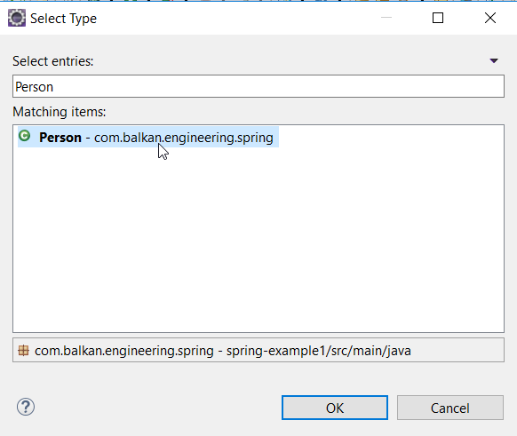
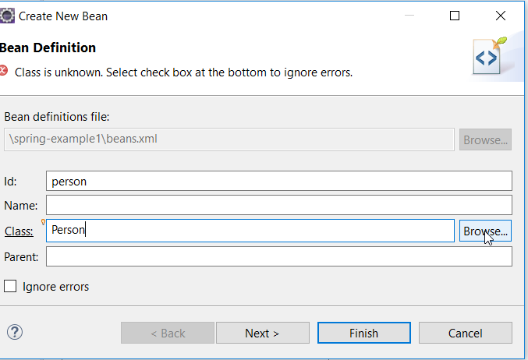
First project
You should add id to this bean and connect it to the class Person

Slide 21
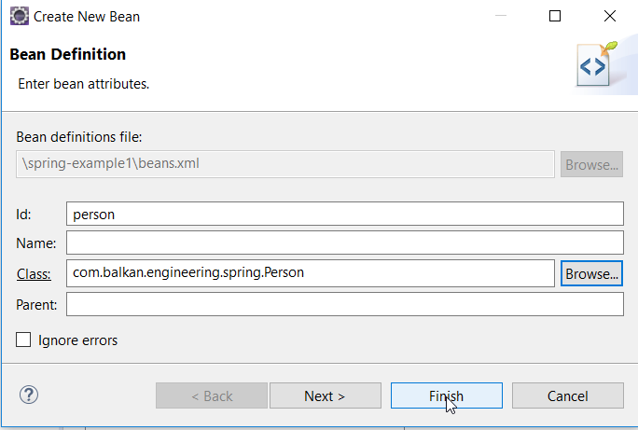
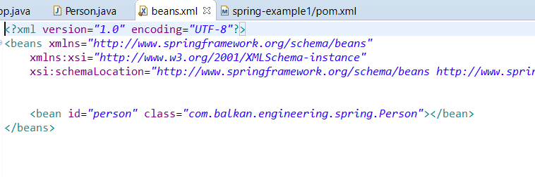
First project

Slide 22
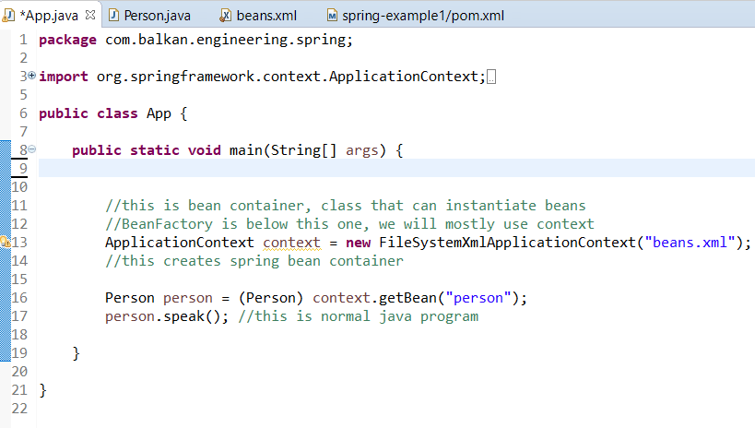
First project
Create simple App.java class

